Slide 1



Use case 1 : Apache httpd
Goal: Host a website of pictolearn on multiple Docker containers running on the same host machine using the httpd server
Container – 1
Container -2
What you will learn?
Building a custom image from Dockerfile.
Running multiple containers out of an image with your website hosted on it.
Docker CLI Commands (All important commands required to form the foundation of understanding Docker)
Host Operating System (Windows, MAC OSX, Linux)
Docker Engine
Infrastructure / Server
Introduction to Docker for Java Developers

Slide 2
Use case Flow
Dockerfile
Build an Image of httpd server with a website to be hosted
List all Images
Inspect image
Run multiple containers from the image
Stop and Start the Container
View Container Logs
Show all containers Running and stopped
Inspect the container
Introduction to Docker for Java Developers

Slide 3
Use case Flow
Apache HTTPD Image with custom httpd.conf and pictolearn website
Build a Image of httpd server with a website to be hosted
Host Operating System (Windows, MAC OSX, Linux)
Docker Engine
Infrastructure / Server
Apache HTTP Image From Docker Hub
Docker Image Structure. Let’s call it my-httpd image.
Introduction to Docker for Java Developers

Slide 4


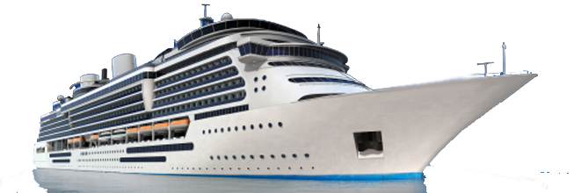
Use case Flow
Introduction to Docker for Java Developers

